Slide 1

Lead Scoring : By Mahesh

Slide 2
Problem Statement
--------------------------
AN EDUCATION COMPANY NAMED X EDUCATION SELLS ONLINE COURSES TO INDUSTRY PROFESSIONALS.
NOW, ALTHOUGH X EDUCATION GETS A LOT OF LEADS, ITS LEAD CONVERSION RATE IS VERY POOR OF ABOUT 30%
THE COMPANY WANTS TO INCREASE IT TO 80%

Slide 3
Goal
Build a logistic regression model to assign a lead score between 0 and 100 to each of the leads which can be used by the company to target potential leads.
A higher score would mean that the lead is hot, i.e. is most likely to convert whereas a lower score would mean that the lead is cold and will mostly not get converted

Slide 4
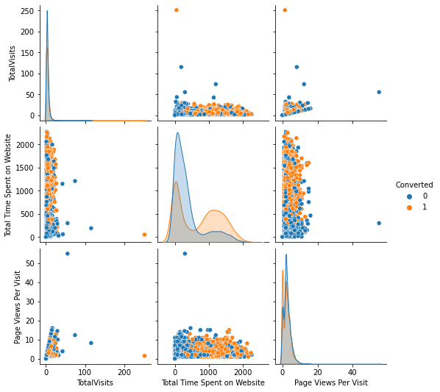
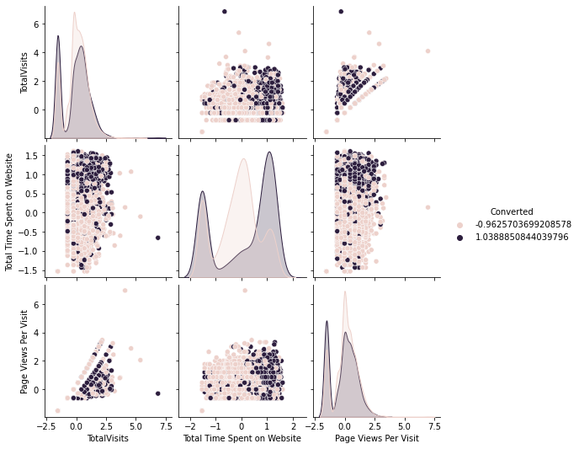
Preparing the Data for Modelling

Slide 5
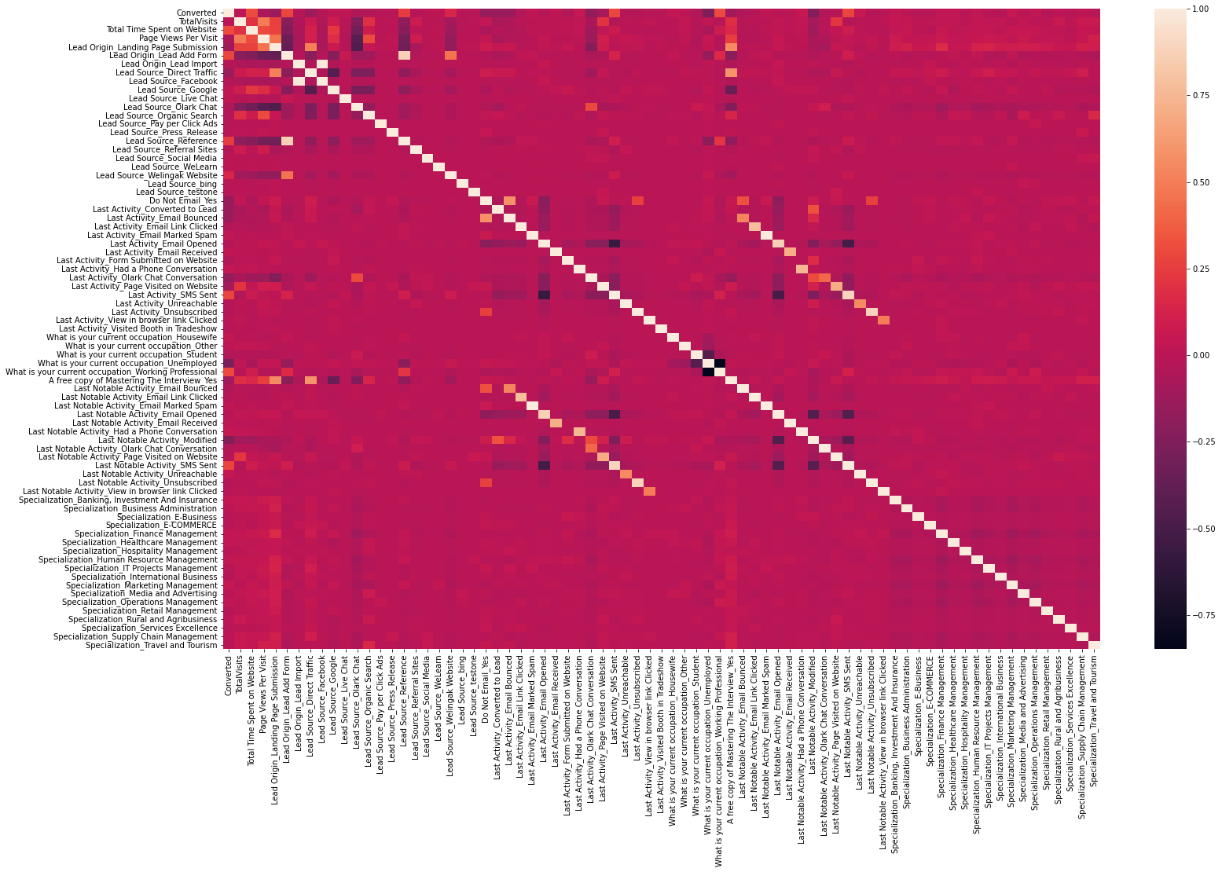
Scaling :
# We notice a few numeric variables in the dataset which have different scales. Hence, proceeding with scaling the variables
# Scale the three numeric features present in the dataset.
# Looking at the correlation table ------->

Slide 6
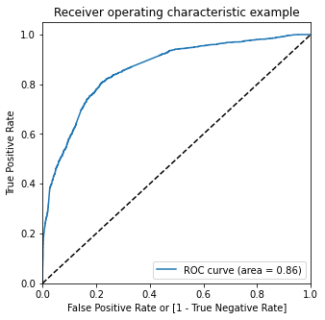
Finding the Optimal Cut-off
The area under the curve of the ROC is 0.86 which is quite good. So we seem to have a good model. Let's also check the sensitivity and specificity tradeoff to find the optimal cutoff point.

Slide 7
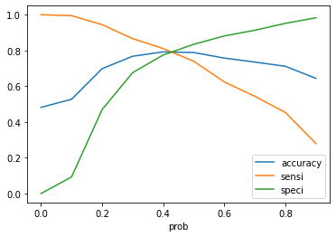
To see the values of accuracy, sensitivity, and specificity at different values of probability cut-offs
As you can see that around 0.42, you get the optimal values of the three metrics. So let's choose 0.42 as our cut-off now.

Slide 8
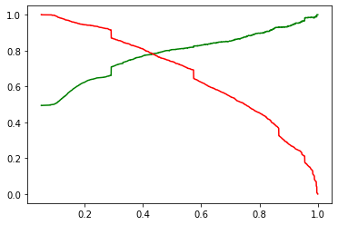
Precision and recall Trade-off Calculate Recall TP/(TP+FN) = Cut-off points is good!!
0.7771056305258259

Slide 9
Conclusion:
Lots of leads generated initially but only a few come out as paying customers by the time the analysis is completed
Potential leads needs to be nurtured in order to get higher lead conversion
'TotalVisits', 'Total Time Spent on Website', 'Page Views Per Visit' contribute most towards the probability of lead getting converted
List of leads must be kept handy to inform them about new courses, services, job offers and future higher studies
Monitor each lead and provide job offerings, information or courses that suits best according to the interest of the leads
Focus on converted leads
Further enquiries and appointments with the leads can be made to determine their intention to join the online courses

